Slide 1



START – Danube Region Project Fund
1st Call

Slide 2
AGENDA
Part 1:
INTRODUCTION AND BASICS
Objectives and principles of the new START pilot initiative
What is a START project?
Basic eligibility criteria
Difference between START, TAF-DRP and other initiatives
START governance and management structure
Calendar

Slide 3
AGENDA
Part 2:
THE FIRST CALL IN DETAIL
Documents / guidelines – online information
Calendar of the first call
Documents / guidelines, online information
The first call in 6 steps and the role of PACs and their Steering Group:
    Application → Pre-selection → Assessment
    Decision → Contracting → Implementation, reporting and closing
Open issues and questions

Slide 4
Objectives of START
  Recommendation of NCPs, July 2013:
  Need to provide Seed Money in the Danube Region, like in the Baltic Sea Region
Objective of START:
  Kick-start project development in the Danube Region and facilitate the financing of transnational projects
  Help organisations and institutions in the Danube Region to develop and implement their project ideas

Slide 5
Principles, facts and figures
Main principles:
  Pilot initiative: a flexible approach is used and adaptations may be brought during implementation
  Seed money: beneficiaries receive a large pre-financing at the beginning of the project implementation (50%) and a second rate at midterm (25%), if certain conditions are fulfilled
  Involvement of PACs in governance of START
  Benchmarking from other Facilities: EUSBSR Seed Money Facility, Visegrad Fund, People-to-People
Total budget: 900.000€
95% EU Commission (funds from EU Parliament); 5% City of Vienna
Timing: 2 Calls (2014, 2015) – closing of the Facility end of 2016

Slide 6
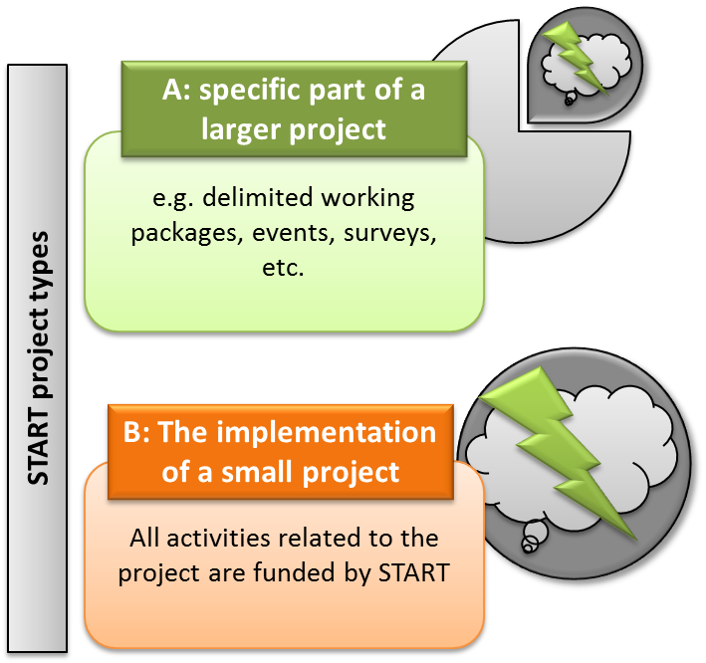
What is a START project?
START supports:
Projects from the entire Danube Region
Projects addressing issues from all Priority Areas
Two types of projects:
A) A specific part of a larger project (total value and duration of the overall project goes beyond the framework of START (yet below 25M€))
B) Implementation of a small project

Slide 7
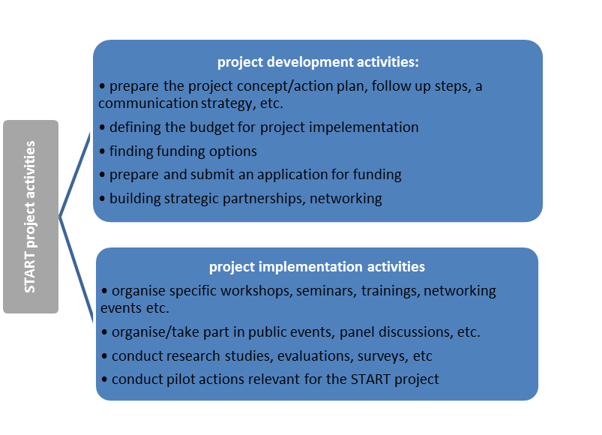
What types of activities are funded?

Slide 8
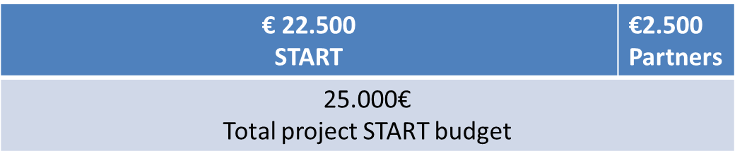
Characteristics of START support
Project duration / START support: between 6 months and 1 year
EU/START allocation: between €10.000 and €40.000
90% of project costs can be reimbursed - START co-finances 90% of the project´s budget – remaining 10% must be brought by the partners (or other non-EU donors)
Example of financing structure:
Official language is English (application, contracting, reporting)

Slide 9
Basic eligibility criteria (I)
Eligible applicants:
  Bodies established under public or private law not having a predominantly industrial or commercial character and having legal personality
  Organisations located in the Danube Region (seat or department dealing with the project) with a preference to non-governmental and non-profit organisations, municipalities and local governments
  Not eligible:
  Individual persons

Slide 10
Basic eligibility criteria (II)
Project partnership:
  At least two partners from two countries of the Danube Region (exceptions possible)
  One partner acts as “Applicant”, once selected as “Lead Partner” (LP).
    LP signs subsidy contract, receives payments, is responsible for management, communication, implementation and coordination of activities
Maximum number of partners: 6 (incl. applicant)

Slide 11
Basic eligibility criteria (III)
Project activities must take place in the Danube Region
  Travel/meetings outside the Danube Region are only eligible if necessary to implement the project activities.
Projects have to reveal public interest
  START does not support projects with a predominant commercial interest
Access to START is not correlated to TAF-DRP or DFD support
  It is not excluded to combine support from these different schemes, but it is no condition

Slide 12





START and other support schemes
START: seed money to finance small projects or a part of a larger project (preparation, work package(s)
TAF-DRP: technical assistance by experts to turn project ideas to bankable/fundable projects (for projects <25Mio €)
Danube Financing Dialogue: match-making opportunities between project promoters and financing organisations (events)
JRC (Joint Research Centre): scientific support to the Danube Strategy (4 clusters)
Budapest Danube Contact Point: technical assistance for large transnational infrastructure projects

Slide 13
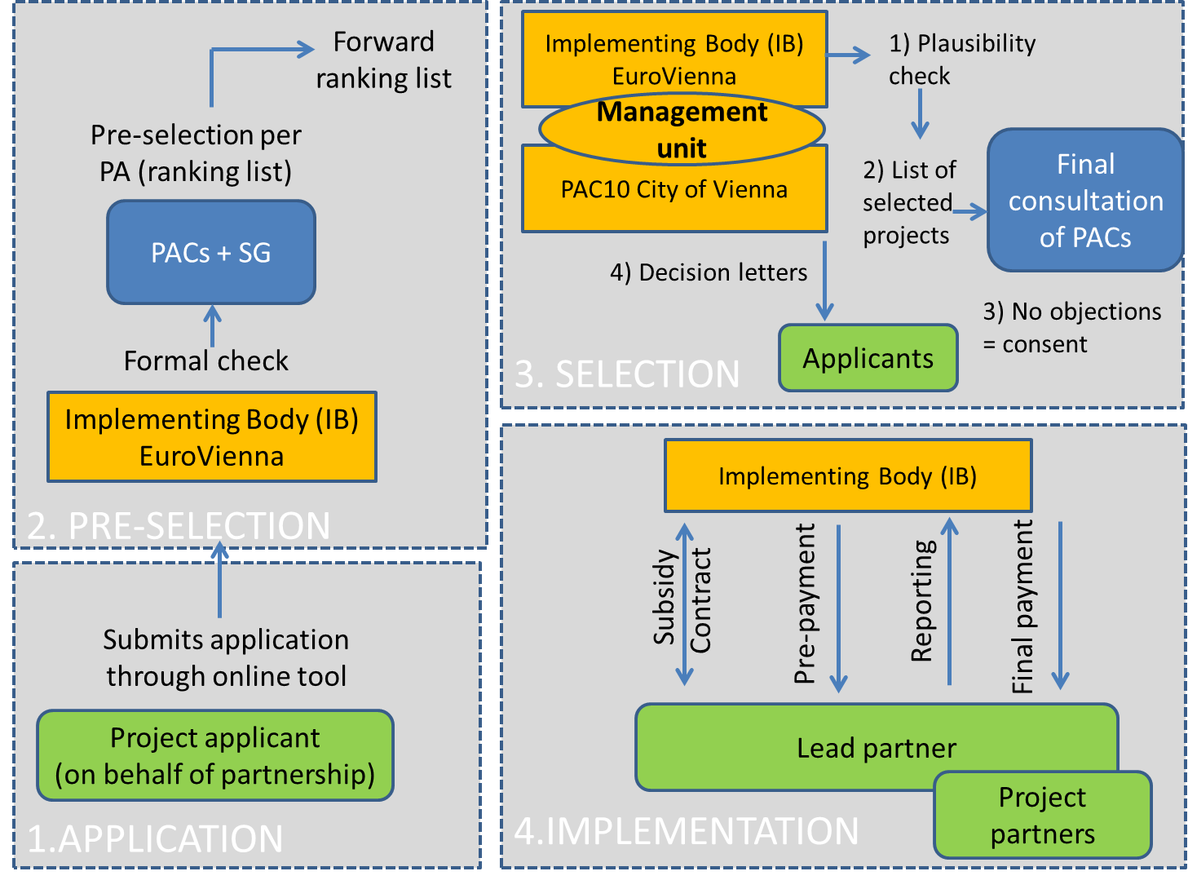
Management structure

Slide 14
Management structure (I)
  Role of EuroVienna - Implementing Body (IB)
  Organisation and dissemination of calls
  Formal check
  Forwarding checked applications incl. total list to PACs
  Plausibility check of project applications
  Contracting of selected projects
  Monitoring/verification of project activities, outputs and expenditure
  Payments to lead partners – recovery where needed
  Certification of project expenditure (outsourced to an auditor)

Slide 15
Management structure (II)
  Role of PAC 10 – City of Vienna
  Participation in project assessment
  Decision-making and validation of selected projects (taking into consideration the thematic and geographic balance between projects and the available budget)
  Communication of decision to applicants
  Reporting to European Commission, City of Vienna, etc.

Slide 16
Management structure (III)
  Role of PACs and their Steering Group
  Publicising START calls (e.g. website, personal meetings, mailings)
  Pre-selection of projects submitted to the Priority Area concerned
  Forwarding of a ranking list of all pre-assessed projects to the IB
  Possibility to comment an the final decision of PAC 10
  If needed, support to the IB and projects during implementation
  Receive a copy of all project reports (midterm and final)

Slide 17
Management structure (IV)
  Role of the lead applicant / lead partner
  Coordination of the preparation of the project application
  Signing and submission of the project application on behalf of the project partnership
  Signs subsidy contract with IB
  Coordinates project activities
  Receives payments – reporting to IB
  Role of European Commission - DG Regional Policy
  As main donor (95%), receives regular reports on implementation and can conduct audits / checks

Slide 18
Provisional calendar

Slide 19
Documents / guidelines
online information
  For applicants - Application pack:
    Guidelines for Applicants
    Application form (submission through online application tool)
    Available from 18th of July on PA10 website
  For PACs and SGs:
    Guidelines for PACs and their Steering Group

Slide 20
Calendar of the first call
18th July 2014 | Launch of the 1st Call on PA10 website email to PACs for publicity of the call
Until 14th September 2014 | Applicants can prepare their application (word template)
15th -17th September 2014 (until 24.00 CET) | Online submission of applications (identification of relevant PA in the application)
18th – 26th September 2014 | Formal check by IB – forwarding total list to all PACs
26 ^{th} September to 21st October | Pre-selection by PACs and SG – forwarding a ranking list of all pre-assessed projects to the IB
22nd October – Mid. November | Final plausibility check by Management Unit
until End November | Outcomes of the selection to PACs - possibility for PACs to comment within one week Decision letters to applicants
Until mid-December | Contracting with selected applicants
2015 | Project implementation

Slide 21
The 1st Call in 6 steps
PACs and their Steering Groups are to play a central role in the preparation, selection and implementation of selected projects.

Slide 22
1) Application – application form
A simple, easy to use and concise application form :
  Focus on aspects relevant for assessment
  Max. 6 partners
  Min. 3 - max. 6 activities
  Pre-defined indicators
  Simple budget structure
  Declaration of applicants (aspects which cannot be verified)

Slide 23
1) Application – application procedure
Completion of application
Signing, printing, scan
15-17th Sept: Upload on online tool:
  Registration
  Upload files: signed scan + word file
  Submission
→ After closing, IB conducts formal check and forwards valid applications to PACs

Slide 24
2) Formal Check by the IB
All applications submitted via the online application tool will be formally checked by the IB alongside following criteria:
    Is the application complete and submitted in the right way?
    Is the applicant (partnership) eligible?
    Is the project eligible? (location, requested amount)
Formally correct applications will be submitted to PACs for pre-selection on 26th of September
Incomplete applications or applications where formal criteria are not fulfilled will not be subject to further assessment. Concerned applicants will be informed.

Slide 25
3) Pre-selection (I)
Duration: 26th Sept to 21st October
Each Priority Area (PA) is free to organise the selection process as they deem appropriate, with involvement of the Steering Group
  Pre-selection: ranking list (1st and 2nd are most relevant to PA)
    Summary of overall pre-selection procedure (results/comments)
  Submission to IB: 21st October

Slide 26
3) Pre-selection (II)
Submitted applications are pre-assessed by the PACs and their Steering Groups alongside following questions:
Applicant and project partners: | It the partnership relevant for the purpose of the project?
Relevance of the project: | Is the project of public interest? Is the project relevant for the EUSDR and for the PA addressed (contribution of project to the PA´s Action Plan)? if the applicant chose the wrong PA, PACs are to inform the IB immediately If START funding is requested to finance a specific part of a larger project: is the overall project relevant for the EUSDR? Is the requested EU grant adequate/justified to reach the project objectives and implement project activities?

Slide 27
3) Pre-selection (III)
Macro-regional dimension or impact of the project | Are the project activities taking place in the Danube Region? Are expected project results of relevance for the Danube Region?
Professional experience of the applicant/ partnership (through quality of the application form): | Is the application clear (language, style), and concise? Is the planned project well described, realistic and feasible? Is there a consistency between planned project objectives, activities and budget?

Slide 28
4) Plausibility check (Oct. – Nov.)
The Management Unit (PAC 10+IB) conducts a plausibility check of project applications forwarded by the PACs taking under consideration the ranking of the projects (1st and 2nd are most important to the PA)
Following elements will be assessed:
  Adequacy between project objectives, planned activities and budget
  Expected change to the status quo
  Plausibility of timeline, indicators
  As START is targeted at the entire Danube Region and all Priority Areas, the geographic and thematic balance will be considered within the assessments.

Slide 29
4) Selection (Nov.)
PAC 10 presents a list with the selection results for all project applications to the PACs (1st and 2nd priority of the ranking list)
  The Management Unit also considers the thematic and geographic balance between submitted applications and the available budget for the call.
Planned decisions can be:
  Approval
  Approval under conditions (including conditions of approval)
  Non-approval
  PACs are asked for comments to the result within a week– if no comments are made, the decision is accepted

Slide 30
Foreseen until the end of 2014 – start projects 2015
Content: Standard subsidy contract incl. deadlines
→ Validated application form is part of the subsidy contract
Subsidy contract to be signed
and returned to the IB by Lead Partner within 4 weeks
Releasing of first pre-payment (50%)
5) Contracting

Slide 31
6) Project implementation
Simplified financial management:
  Use of simplified cost options for staff, meetings/events and partly for travel and accomodation – based on applicable rates in other EU programmes
  Control/audit centralised
Reporting:
  Midterm and final report (all reports sent to PACs as well)
  Online reporting, online declaration of costs
Payments:
  Up to 75% pre-financing:
    50% pre-payment after signing of the subsidy contract
    25% pre-payment after validation of midterm report (if >30% of budget spent)
  Balance payment after closing of the project – clearing of outstanding issues
  Recovery procedure if needed

Slide 32
Overall management of START
Review: START = pilot-initiative → possible adaptations after the first call (consultation of PACs).
Overall monitoring: by the IB, through online reporting tool
Reporting: 2 progress reports per year to European Commission / DG Regional Policy (PACs/SG will be informed)
Closing: end of 2016

